Slide 1
selenium
Annotation, Playing TestNG xml, Listeners TestNG

Slide 2
TestNG
TestNG @annotation
@Beforesuite
@Beforetest
@Beforeclass
@Beforemethod
@Test
@Aftermethod
@Afterclass
@Aftertest
@Aftersuite

Slide 3
XML File Format
<?xml version="1.0" encoding="UTF-8"?>
<!DOCTYPE suite SYSTEM "http://testng.org/testng-1.0.dtd">
<suite name="Suite">
<test name="carLoan">
<classes>
<class name="Package1.testbase"/>
<class name="Package1.carloan"/>
</classes>
</test>
<test name="homeLoan">
<classes>
<class name="Package1.testbase"/>
<class name="Package1.homeloan">
</class>
</classes>
</test>
</suite>
Note : No need to mention class in each module only mention class any one module
@Beforesuite : run always once within project
@BeforeTest : run always before module So here
Two module carloan and homloan- run two times
Note : you need to mention class in each module
@AfterTest : run always after module So here
Two module carloan and homloan- run two times
@Aftersuite : run always once within project
Note : No need to mention class in each module only mention class any one module

Slide 4
Class 1
Class 2
package Package1;
import org.testng.Assert;
import org.testng.annotations.AfterClass;
import org.testng.annotations.BeforeClass;
import org.testng.annotations.Test;
public class carloan {
@Test
public void CarLoan()
{
System.out.println("CarLoan");
}
package Package1;
import org.testng.Assert;
import org.testng.annotations.AfterClass;
import org.testng.annotations.BeforeClass;
import org.testng.annotations.Test;
public class homeloan {
@Test
public void HomeLoan()
{
System.out.println(“HomeLoan");
}
@Beforeclass : // run always ones within before class
@Afterclass : // run always ones within after class
@Beforeclass : // run always ones within before class
@Afterclass : // run always ones within after class
Note : Here two different @Beforeclass and @Afterclass because scope of these two annotation within
class only So every class has separated these two annotation.

Slide 5
package Package1;
import org.testng.Assert;
import org.testng.annotations.AfterClass;
import org.testng.annotations.BeforeClass;
import org.testng.annotations.Test;
public class carloan {
@Test
public void Carloan()
{
System.out.println("CarLoan");
}
@Test
public void Carloan1()
{
System.out.println("CarLoan");
}
@Beforemethod : run always before test So here
Two test carloan and carloan1 run two times
Note : @BeforeMethod and @AfterMethod scope of these two annotation within
class only So every class has separated these two annotation.
@Aftermethod : run always after test So here
Two test carloan and carloan1 run two times

Slide 6
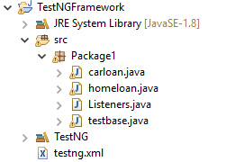
TestNG @annotation Example
Structure of Project

Slide 7
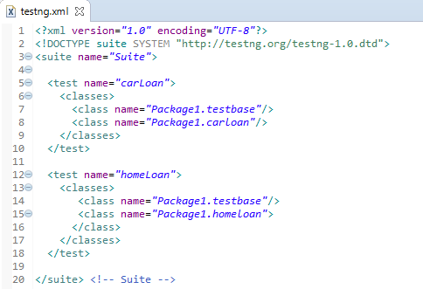
testng.xml

Slide 8
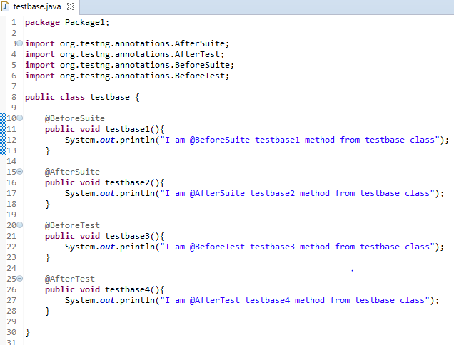
testbase.class

Slide 9
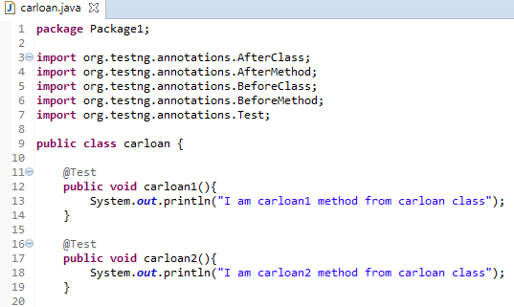
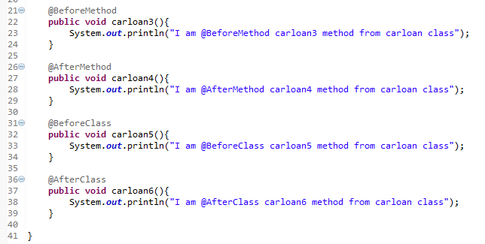
carloan.class

Slide 10
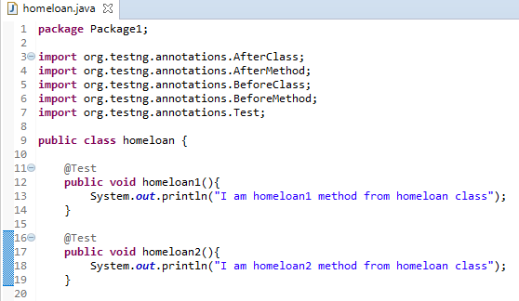
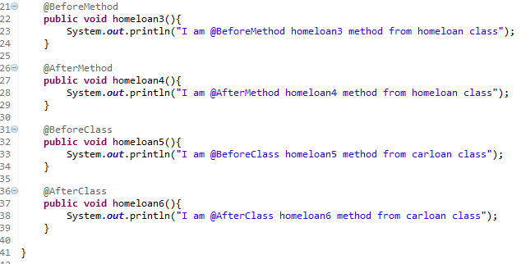
homeloan.class

Slide 11
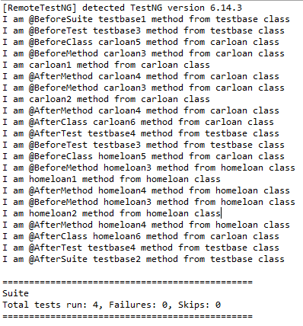
Output

Slide 12
I am @BeforeSuite testbase1 method from testbase class
I am @BeforeTest testbase3 method from testbase class
I am @BeforeClass carloan5 method from carloan class
I am @BeforeMethod carloan3 method from carloan class
@Test I am carloan1 method from carloan class
I am @AfterMethod carloan4 method from carloan class
I am @BeforeMethod carloan3 method from carloan class
@Test I am carloan2 method from carloan class
I am @AfterMethod carloan4 method from carloan class
I am @AfterClass carloan6 method from carloan class
I am @AfterTest testbase4 method from testbase class
I am @BeforeTest testbase3 method from testbase class
I am @BeforeClass homeloan5 method from carloan class
I am @BeforeMethod homeloan3 method from homeloan class
@Test I am homeloan1 method from homeloan class
I am @AfterMethod homeloan4 method from homeloan class
I am @BeforeMethod homeloan3 method from homeloan class
@Test I am homeloan2 method from homeloan class
I am @AfterMethod homeloan4 method from homeloan class
I am @AfterClass homeloan6 method from carloan class
I am @AfterTest testbase4 method from testbase class
I am @AfterSuite testbase2 method from testbase class

Slide 13
Features of TestNG
<test name="carLoan">
<classes>
<class name="Package1.testbase"/>
<class name="Package1.carloan">
<methods>
<exclude name="carloan1"/>
</methods>
</class>
</classes>
</test>
Scenario 1 :
If you want to skip carloan1 testcases which is under carloan class
<test name="carLoan">
<classes>
<class name="Package1.testbase"/>
<class name="Package1.carloan">
<methods>
<exclude name="car.*"/>
</methods>
</class>
</classes>
</test>
Scenario 2 :
If you want to skip testcases which name start from car

Slide 14
@Test(enabled=false)
public void carloan1(){
System.out.println("I am carloan1 method from carloan class");
}
Scenario 3 :
If you know the test case fail any reason and you don’t want to show in report/skip these test case
Scenario 4 :
If you know test case need time before run then give Time to wait
@Test(timeOut=4000)
public void carloan1(){
System.out.println("I am carloan1 method from carloan class");
}

Slide 15
Scenario 5 :
If run only selected testcases then use groups
class file :
@Test(groups={"smoke"})
public void carloan1(){
System.out.println("I am carloan1 method from carloan class");
}
@Test(groups={"smoke"})
public void carloan2(){
System.out.println("I am carloan2 method from carloan class");
}
@Test
public void carloan20(){
System.out.println("I am carloan20 method from carloan class");
}
Xml file :
<test name="carLoan">
<groups>
<run>
<include name = "smoke" />
</run>
</groups>
<classes>
<class name="Package1.testbase"/>
<class name="Package1.carloan"/>
</classes>
</test>
Here only those test case are run whose groups name is smoke So carloan20 not execute
We can write exclude also instead of include then these test cases are not run

Slide 16
@Test(dependsOnMethods= {"carloan2"})
public void carloan1(){
System.out.println("I am carloan1 method from carloan class");
}
@Test
public void carloan2(){
System.out.println("I am carloan2 method from carloan class");
}
Scenario 6 :
If any testcase is depend on another testcase and
You want dependent test case run before the execute testcase
Can add multiple dependent testcases also
@Test(priority = 1)
public void carloan1(){
System.out.println("I am carloan1 method from carloan class");
}
@Test(priority = -1)
public void carloan2(){
System.out.println("I am carloan2 method from carloan class");
}
@Test(priority = 0)
public void carloan20(){
System.out.println("I am carloan20 method from carloan class");
}
Scenario 7 :
If you want to run test cases as priority

Slide 17
Scenario 8
Scenario 8 :
Pass value from xml file using parameter
class file :
@Parameters({"url"})
@Test
public void carloan1(String url){
System.out.println(url);
}
Xml file :
<parameter name="url" value="google.com"/>
<test name="carLoan">
<classes>
<class name="Package1.testbase"/>
<class name="Package1.carloan"/>
</classes>
</test>
Output:
google.com

Slide 18
@Test(dataProvider="getData")
public void carloan1(String URL, String name){
System.out.println(url);
System.out.println(name);
}
Scenario 9 :
Using Data Provider you can pass the values
class file :
@DataProvider
public Object[][] getData()
{
Object[][] data = new Object[2][2];
data[0][0]="google.com";
data[0][1]="google";
data[1][0]="demo.com";
data[1][1]="demo";
return data;
}
@DataProvider
public Object[][] getData()
{
return new Object[][]
{
{ "Guru99", "India" },
{ "Krishna", "UK" },
};
}
OR

Slide 19
Listeners in TestNG
Xml file :
<listeners>
<listener class-name="Package1.Listeners"/>
</listeners>
<test name="carLoan">
<classes>
<class name="Package1.testbase"/>
<class name="Package1.carloan"/>
</classes>
</test>
Listners.class

Slide 20
package Package1;
import org.testng.ITestContext;
import org.testng.ITestListener;
import org.testng.ITestResult;
public class Listeners implements ITestListener {
@Override
public void onFinish(ITestContext arg0) {
// TODO Auto-generated method stub
}
@Override
public void onStart(ITestContext arg0) {
// TODO Auto-generated method stub
}
@Override
public void onTestSuccess(ITestResult arg0) {
// TODO Auto-generated method stub
System.out.println("Hey I am onTestSuccess");
}
@Override
public void onTestFailure(ITestResult arg0) {
// TODO Auto-generated method stub
System.out.println("Hey I am onTestFailure" +arg0.getName());
}
@Override
public void onTestSkipped(ITestResult arg0) {
// TODO Auto-generated method stub
}
@Override
public void onTestStart(ITestResult arg0) {
// TODO Auto-generated method stub
}
}
@Override
public void onTestFailedButWithinSuccessPercentage(ITestResult arg0) {
// TODO Auto-generated method stub
}

